Slide 1
Workshop
Neuromorphic Electronic Design
Design and Implementation of an 8-bit
LFSR on FPGA

Slide 2
Neuromorphic electronic design, Workshop week 2.
Contents
Part 1: Design of shift registers
Verilog code for shift-right and shift-left registers in gate level
Verilog coding for shift registers in RTL level
Verilog coding for shift register test-bench
Part 2: Design of an 8-bit LFSR
Verilog code for an LFSR in gate level
Verilog coding for the same LFSR in RTL level
Verilog coding for LFSR test-bench
Visualise the histogram of the LFSR output using Python

Slide 3
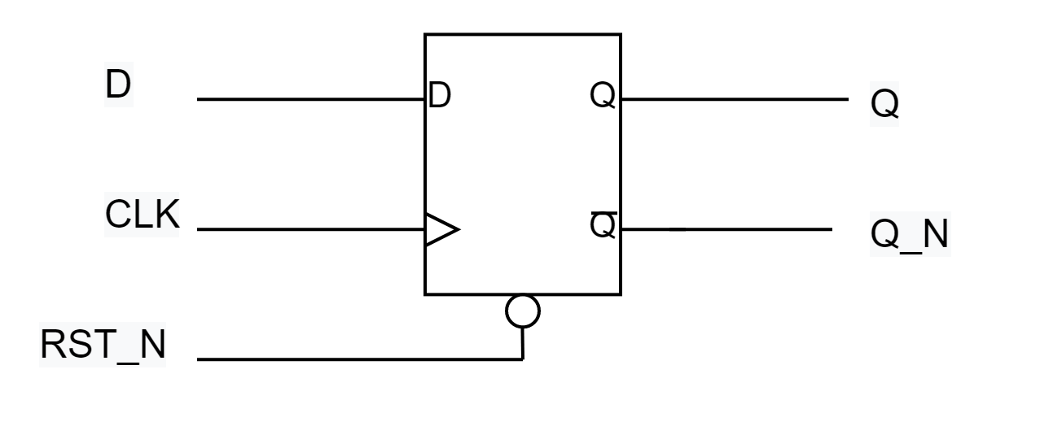
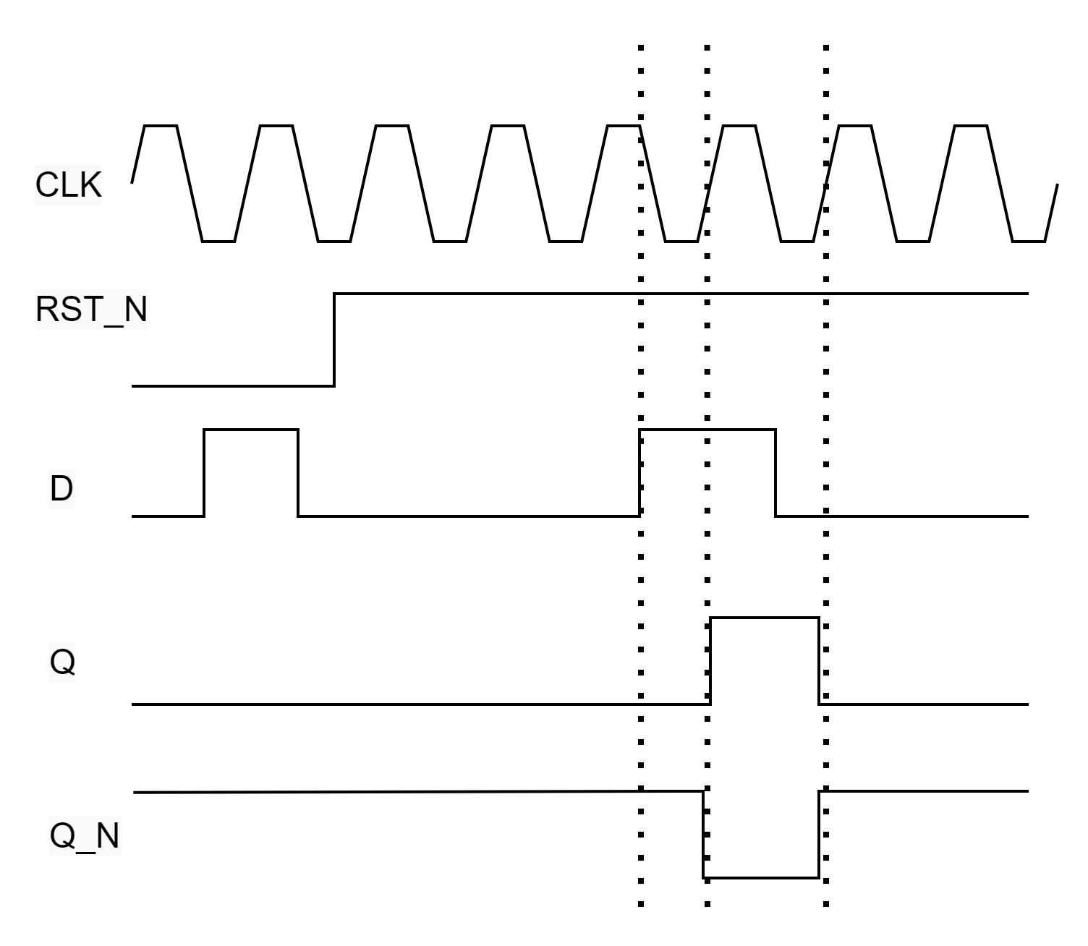
Flip flops, the primitives
Flip plops are primitive components of shift registers or any sequential logic.

Slide 4
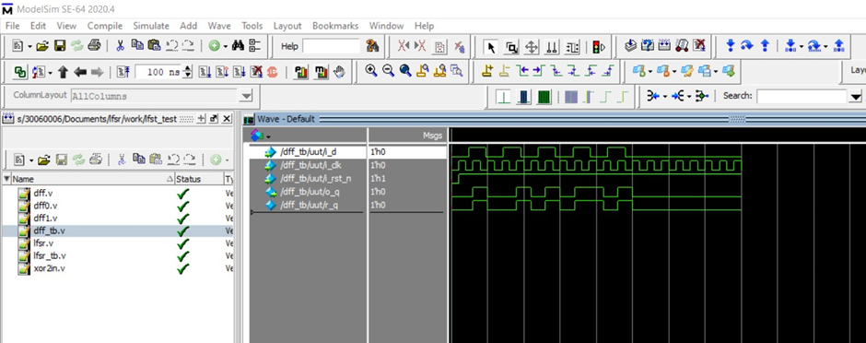
D type flip-flop in Verilog
How to describe a D type flip-flop in Verilog?
module dff
(
input i_d,
input i_clk,
input i_rst_n,
output o_q
);
reg r_q;
assign o_q = r_q;
always@(posedge i_clk or negedge i_rst_n)
begin
if(!i_rst_n)
r_q<= 0;
else
r_q<=i_d;
end
end
endmodule
`timescale 1ns/1ns
module dff_tb();
reg r_d, r_clk, r_rst_n;
wire w_q;
integer i;
dff uut(
.i_d(r_d),
.i_clk(r_clk),
.i_rst_n(r_rst_n),
.o_q(w_q)
);
initial
begin
r_clk = 0;
r_rst_n = 0;
r_d = 0;
#10 r_rst_n = 1;
end
always #10 r_clk <= ~r_clk;
initial
begin
for( i= 0; i< 10; i=i+1)
#24 r_d <= ~r_d;
end
endmodule

Slide 5
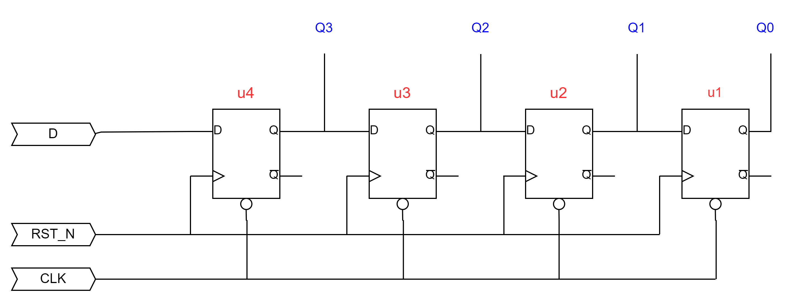
Shift registers
Shift right
4’b1010 => 4’b0101 => 4’b0010
If D=0 a shift-right is divide by 2

Slide 6
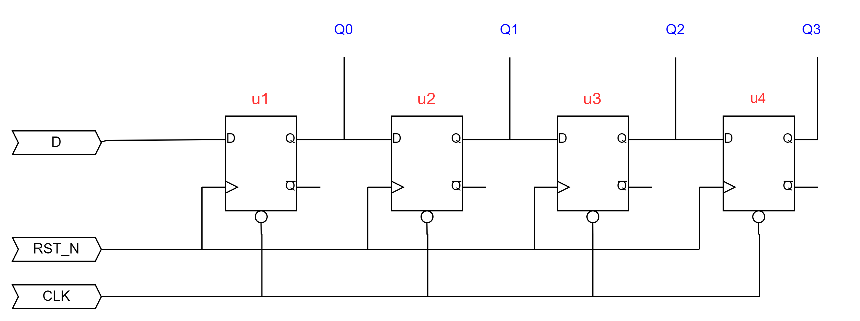
Shift registers
Shift Left
If D=0 a shift-left operation is times 2

Slide 7
Shift registers
module four_bit_shift_right
(
input i_d,
input i_clk,
input i_rst_n,
output [3:0] o_q
);
wire [3:0] w_wire;
dff u1
(
.i_d(w_wire[1]),
.i_clk(i_clk),
.i_rst_n(i_rst_n),
.o_q(w_wire[0])
);
dff u2
(
.i_d(w_wire[2]),
.i_clk(i_clk),
.i_rst_n(i_rst_n),
.o_q(w_wire[1])
);
dff u3
(
.i_d(w_wire[3]),
.i_clk(i_clk),
.i_rst_n(i_rst_n),
.o_q(w_wire[2])
);
dff u4
(
.i_d(i_d),
.i_clk(i_clk),
.i_rst_n(i_rst_n),
.o_q(w_wire[3])
);
assign o_q = w_wire;
endmodule
Now we instantiate D-flip-flop (dff) and connect them together to make a shift register.

Slide 8
Shift registers (RTL)
Write a test-bench for your shift-register.
Design a 4-bit shift-left register.
How do you write the RTL description of a 4-bit shift right register?
module four_bit_shift_right
(
Input i_d,
input i_clk,
input i_rst_n,
output [3:0] o_q
);
reg [3:0] r_reg;
always@(posedge i_clk or negedge i_rst_n)
begin
if(!i_rst_n)
r_reg<= 4’b0000;
else
begin
r_reg[2:0] <= r_reg[3:1];
r_reg[3]<=i_d;
end
end
end
endmodule
3 | 2 | 1 | 0
in
out

Slide 9
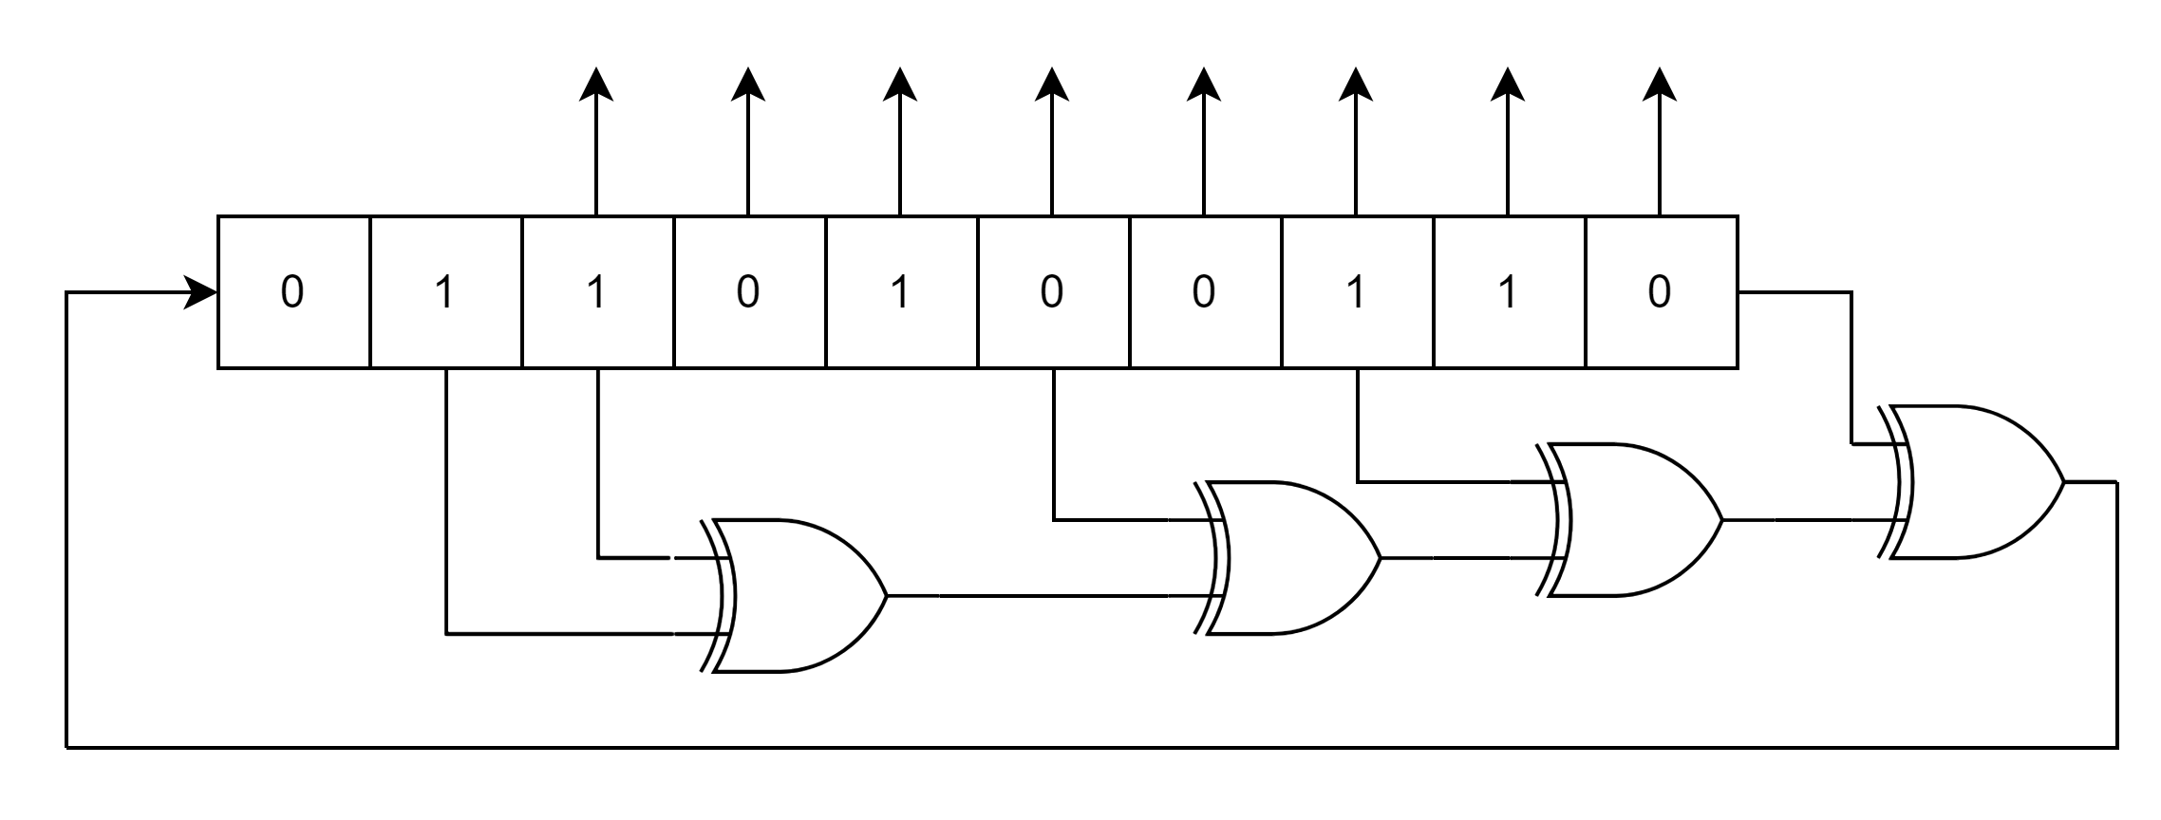
Design of an 8-bit LFSR

Slide 10
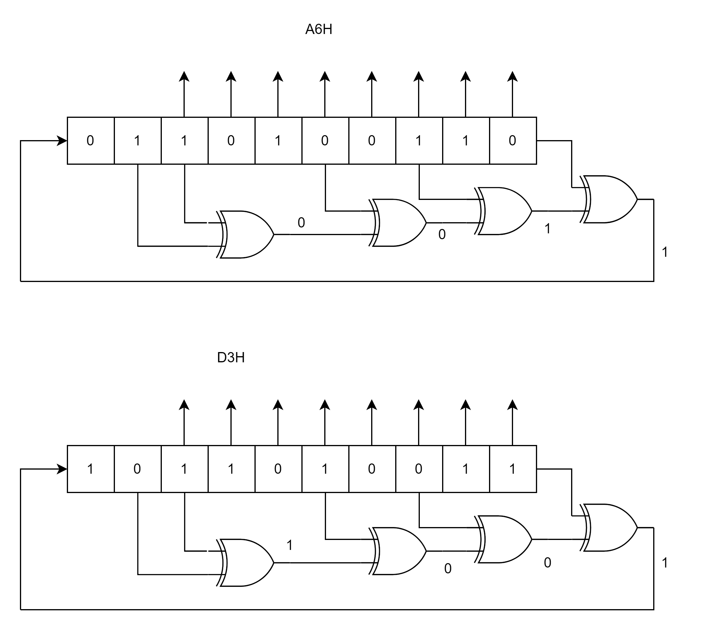
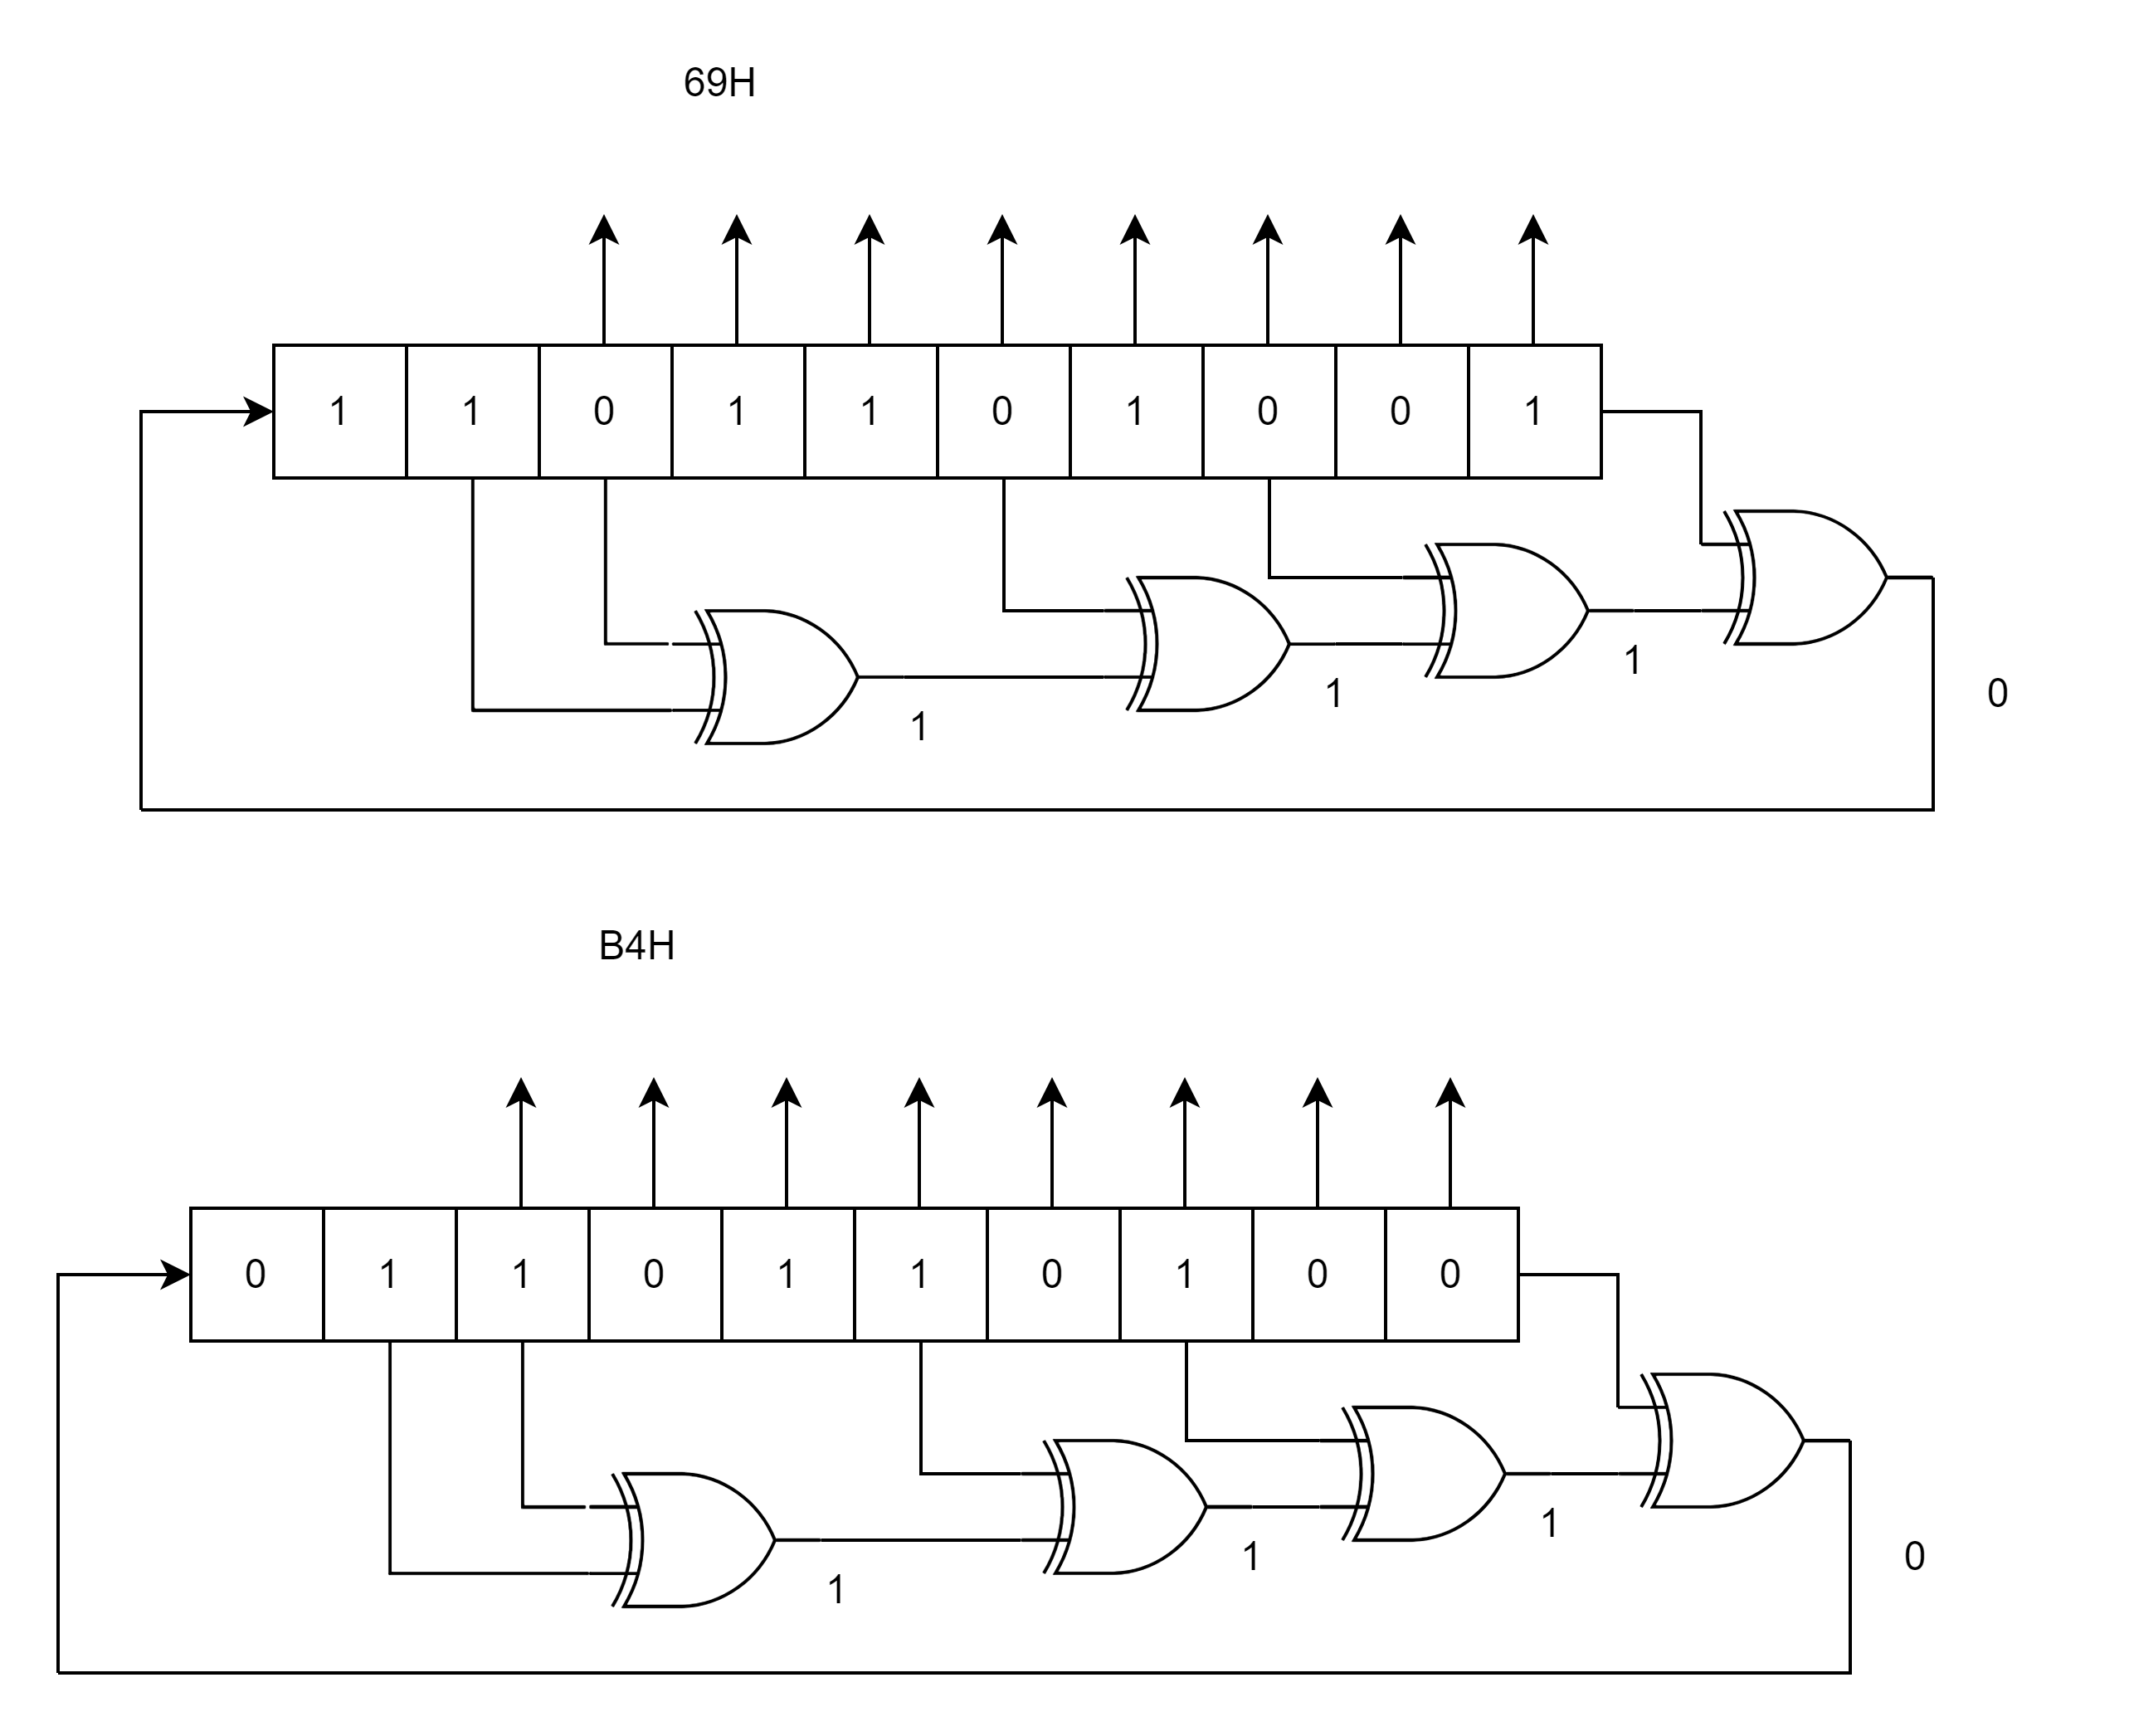
four states of the LFSR
Reset
second clock
First clock
Third clock

Slide 11
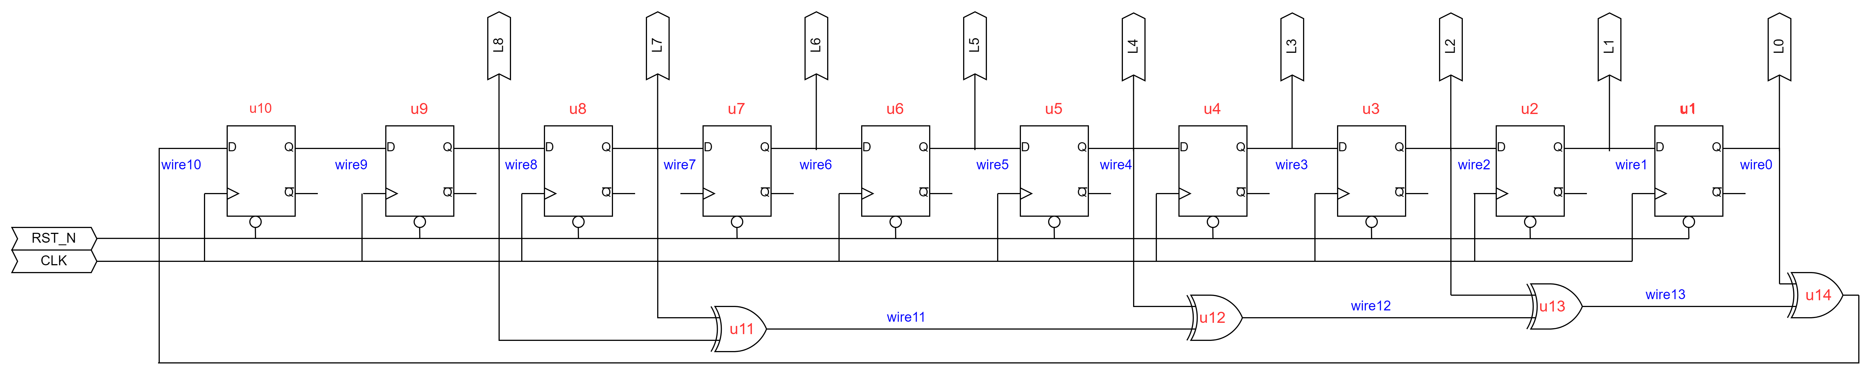
RTL design of an 8-bit LFSR seed – 10’h1A6
0
1
1
0
1
0
0
1
1
0

Slide 12
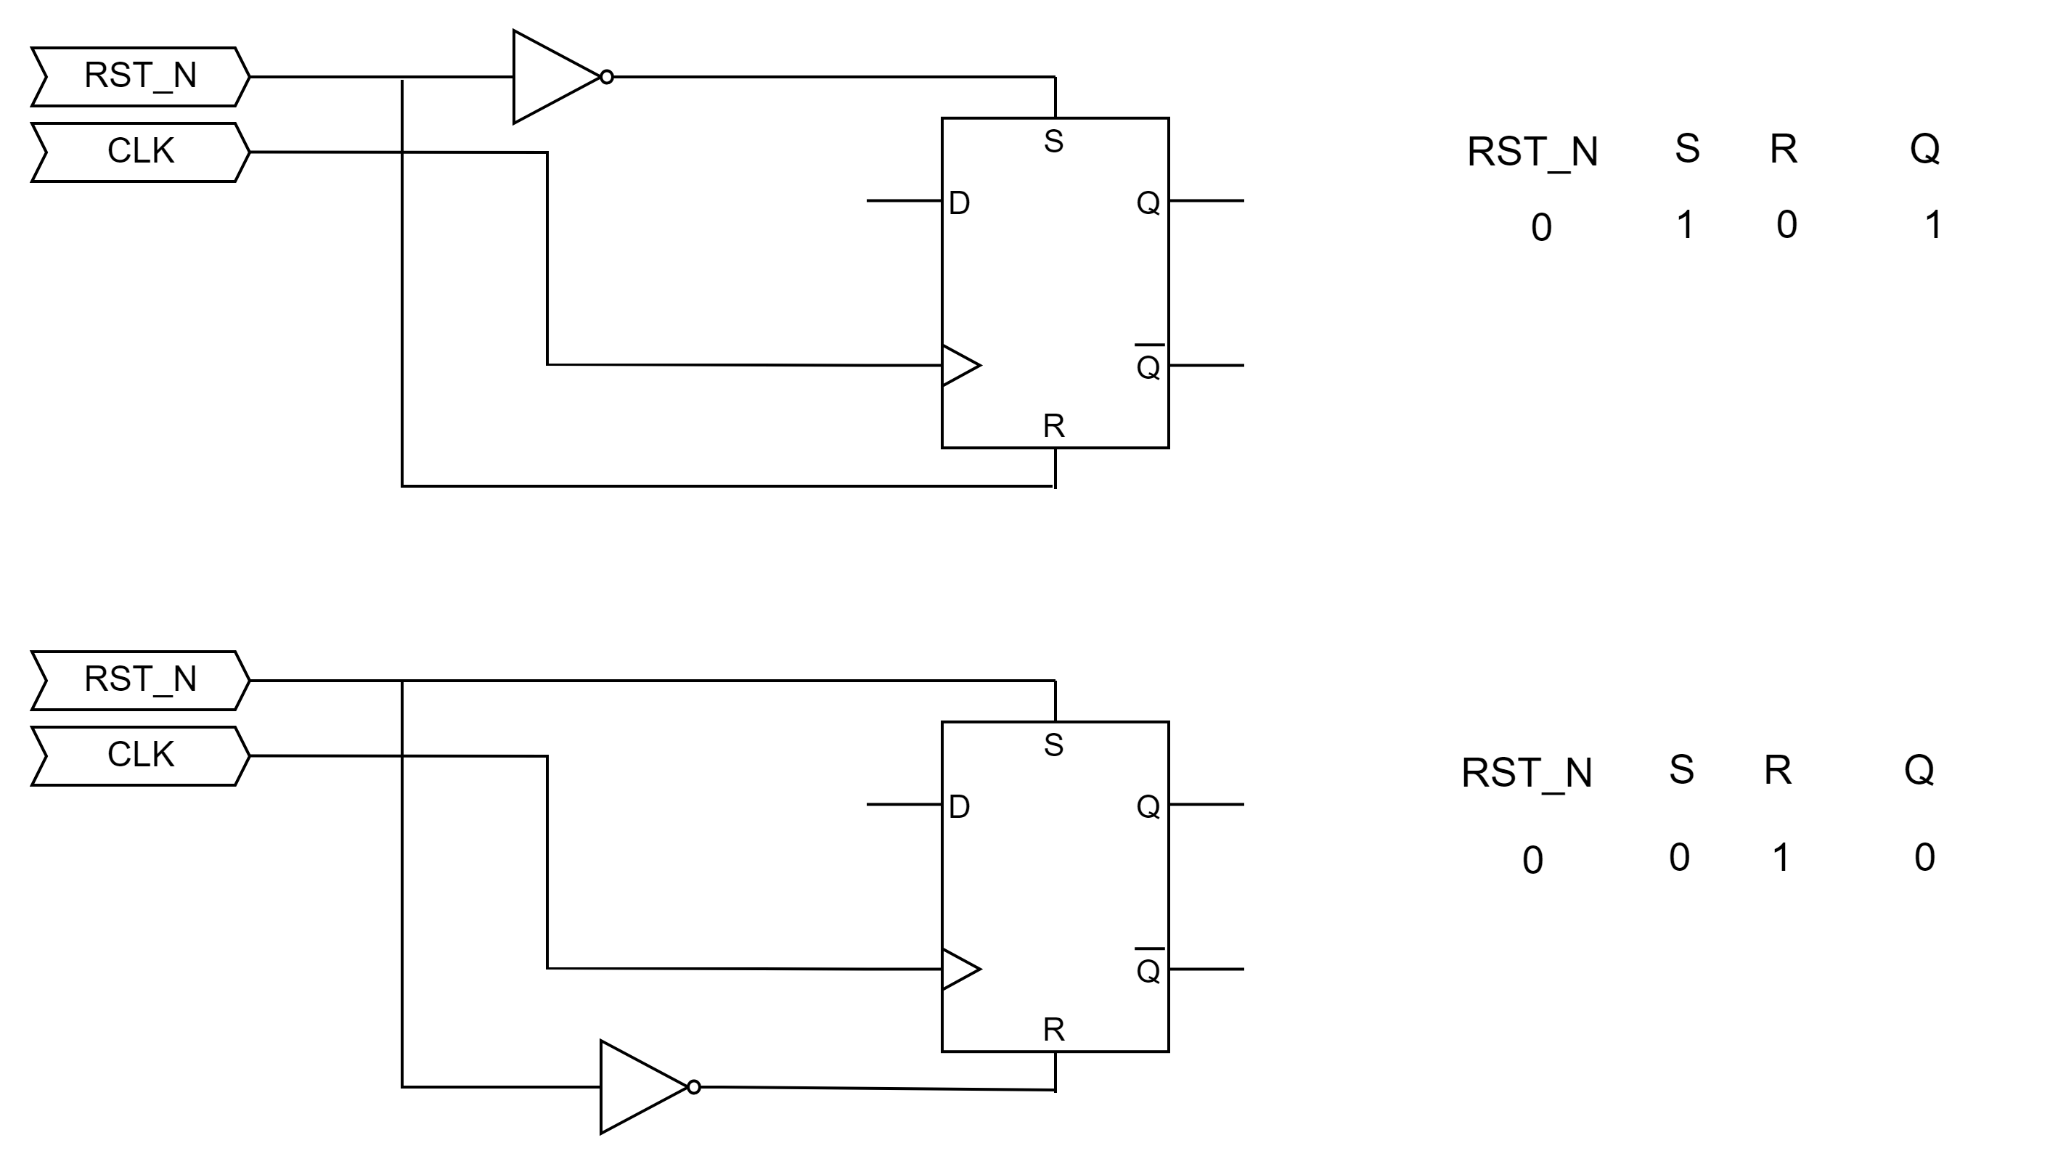
D flip-flops reset to 1/0

Slide 13
D flip-flops reset to 1/0
module dff0
(
input i_clk,
input i_rst_n,
input i_d,
output o_q
);
reg r_q;
assign o_q = r_q;
always @(posedge i_clk or negedge i_rst_n)
begin
if(!i_rst_n)
r_q <= 1'b0;
else
r_q <= i_d;
end
endmodule
module dff1
(
input i_clk,
input i_rst_n,
input i_d,
output o_q
);
reg r_q;
assign o_q = r_q;
always @(posedge i_clk or negedge i_rst_n)
begin
if(!i_rst_n)
r_q <= 1'b1;
else
r_q <= i_d;
end
endmodule
module xor2in
(
input i_a,
input i_b,
output o_c
);
assign o_c = i_a ^ i_b;
endmodule

Slide 14
Gate level code for the LFSR
module lfsr(
input i_clk,
input i_rst_n,
output [7:0] o_lfsr);
wire [13:0] w_wire;
assign o_lfsr[7:0] = w_wire[7:0];
// Gate Level design
dff0 u1(
.i_clk(i_clk),
.i_rst_n(i_rst_n),
.i_d(w_wire[1]),
.o_q(w_wire[0])
);
dff1 u2(
.i_clk(i_clk),
.i_rst_n(i_rst_n),
.i_d(w_wire[2]),
.o_q(w_wire[1])
);
dff1 u3(
.i_clk(i_clk),
.i_rst_n(i_rst_n),
.i_d(w_wire[3]),
.o_q(w_wire[2])
);
dff0 u4(
.i_clk(i_clk),
.i_rst_n(i_rst_n),
.i_d(w_wire[4]),
.o_q(w_wire[3])
);
dff0 u5(
.i_clk(i_clk),
.i_rst_n(i_rst_n),
.i_d(w_wire[5]),
.o_q(w_wire[4])
);
dff1 u6(
.i_clk(i_clk),
.i_rst_n(i_rst_n),
.i_d(w_wire[6]),
.o_q(w_wire[5])
);
dff0 u7(
.i_clk(i_clk),
.i_rst_n(i_rst_n),
.i_d(w_wire[7]),
.o_q(w_wire[6])
);
dff1 u8(
.i_clk(i_clk),
.i_rst_n(i_rst_n),
.i_d(w_wire[8]),
.o_q(w_wire[7])
);
dff1 u9(.i_clk(i_clk),
.i_rst_n(i_rst_n),
.i_d(w_wire[9]),
.o_q(w_wire[8])
);
dff0 u10(
.i_clk(i_clk),
.i_rst_n(i_rst_n),
.i_d(w_wire[10]),
.o_q(w_wire[9])
);
xor2in u11(
.i_a(w_wire[7]),
.i_b(w_wire[8]),
.o_c(w_wire[11])
);
. xor2in u12(
.i_a(w_wire[4]),
.i_b(w_wire[11]), .o_c(w_wire[12])
);
xor2in u13(
.i_a(w_wire[2]), .i_b(w_wire[12]), .o_c(w_wire[13])
);
xor2in u14(
.i_a(w_wire[0]), .i_b(w_wire[13]), .o_c(w_wire[10])
);
endmodule

Slide 15
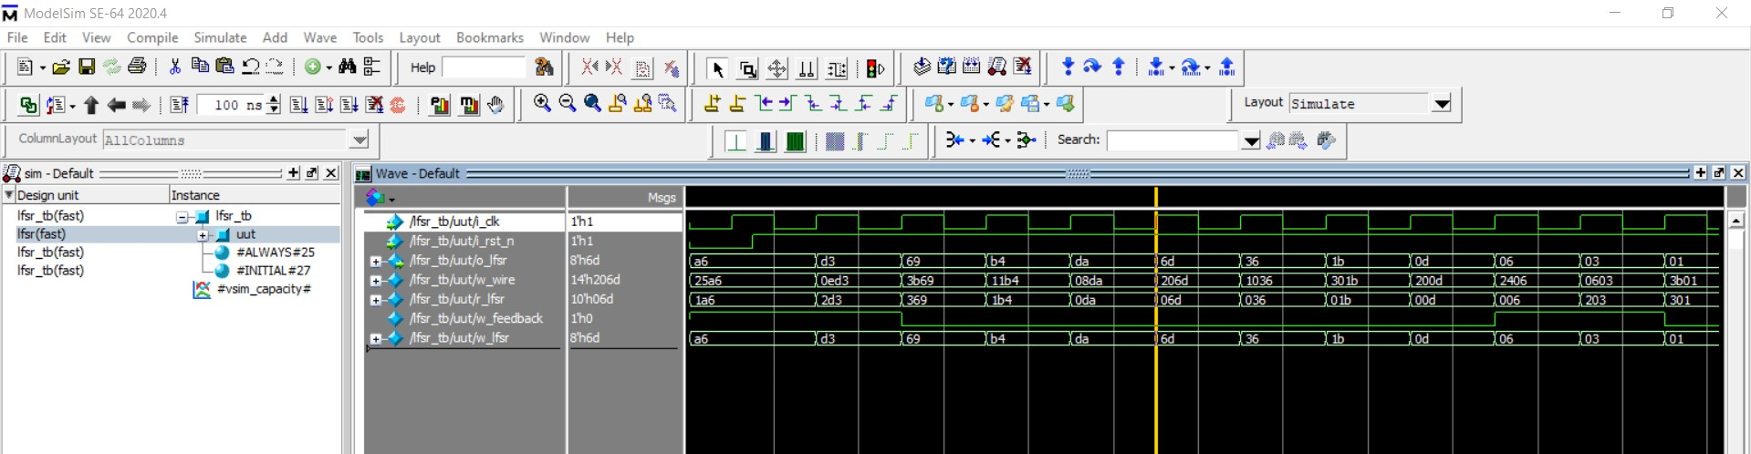
Test-bench for LFSR
`timescale 1ns/1ns
module lfsr_tb();
reg r_clk;
reg r_rst_n;
wire [7:0] w_lfsr;
integer f,i;
lfsr uut
(
.i_clk(r_clk),
.i_rst_n(r_rst_n),
.o_lfsr(w_lfsr)
);
initial
begin
r_clk = 0;
r_rst_n = 0;
#15 r_rst_n = 1;
end
always #10 r_clk <= ~r_clk;
initial
begin
f = $fopen("output.csv","w");
@(posedge r_rst_n); //Wait for reset to be released
@(posedge r_clk); //Wait for first clock out of reset
for (i = 0; i<2550; i=i+1)
begin
@(posedge r_clk);
$fwrite(f,"%d,\n", w_lfsr);
end
$fclose(f);
end
endmodule

Slide 16
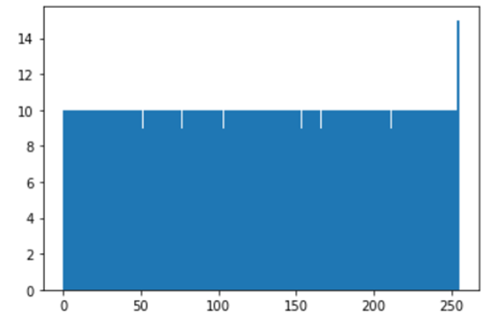
LFSR Output
#Python code to analyse LFSR’s
import matplotlib.pyplot as plt
import pandas as pd
df = pd.read_csv(r'\output.csv')
df.columns = ['A','B']
df.drop(['B'], axis=1, inplace=True)
plt.hist(df, bins = 255)
plt.show()

Slide 17
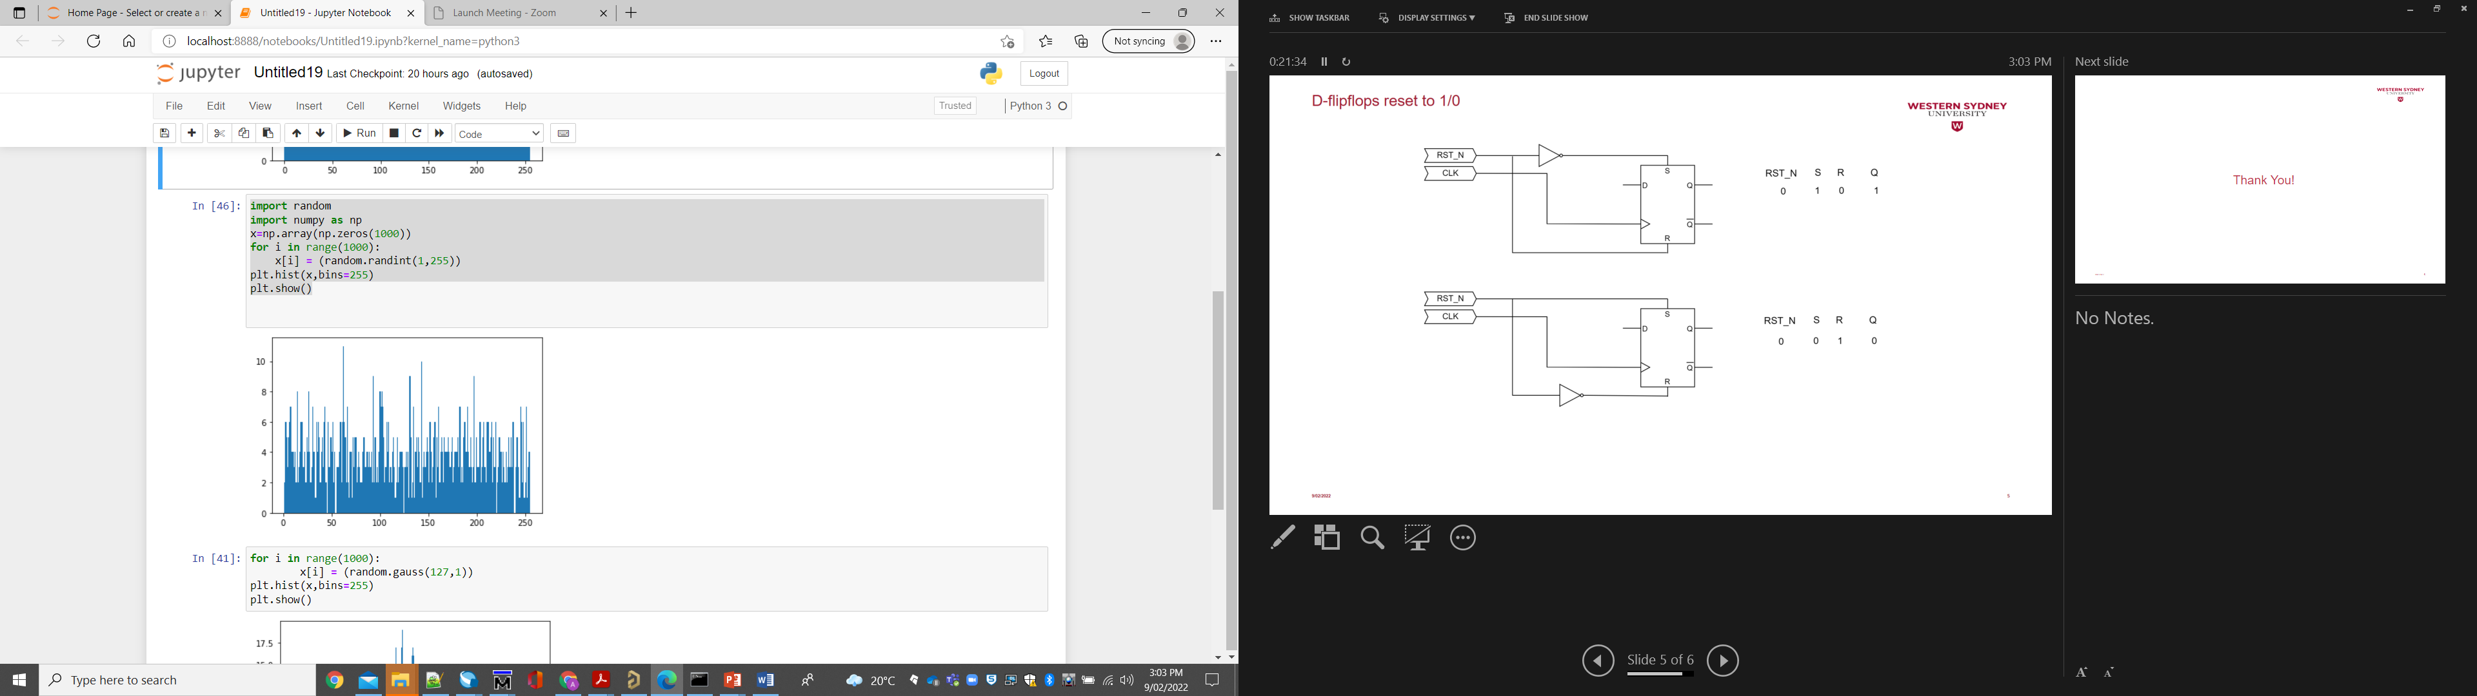
Python randint() 8-bit integer histogram
import random
import numpy as np
x=np.array(np.zeros(1000))
for i in range(1000):
x[i] = (random.randint(1,255))
plt.hist(x,bins=255)
plt.show()

Slide 18
Q&A

